Slide 1

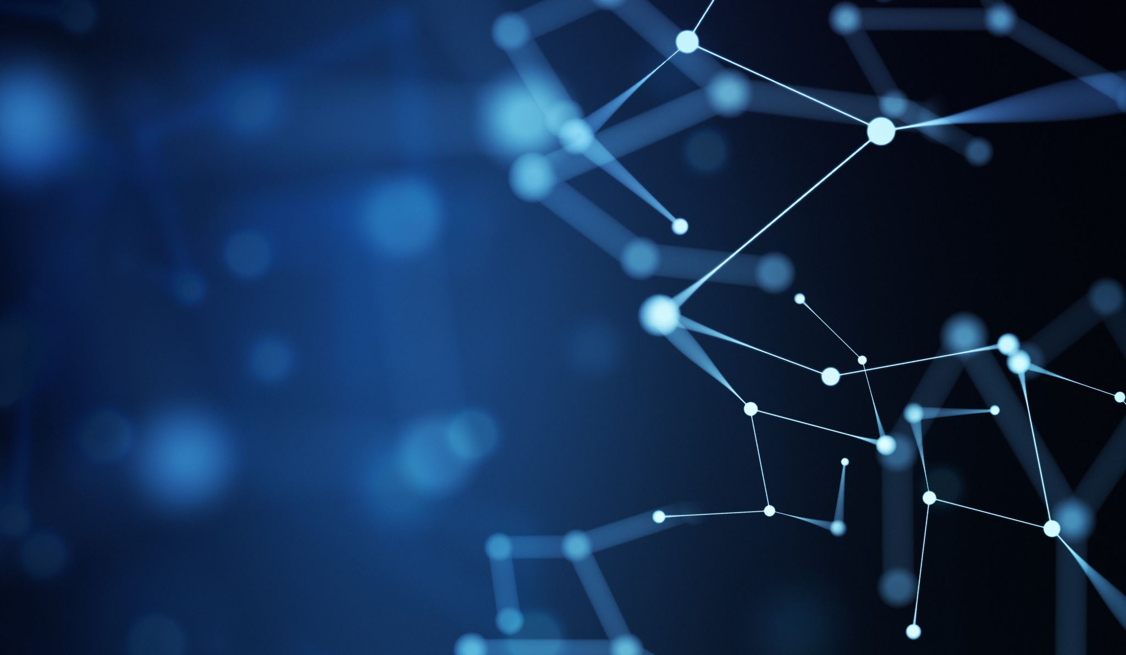
INTERNET OF THINGS
SYED MUHAMMAD MOOAZAM
LEAD IOT INSTRUCTOR
https://www.linkedin.com/in/mooazam/

Slide 2

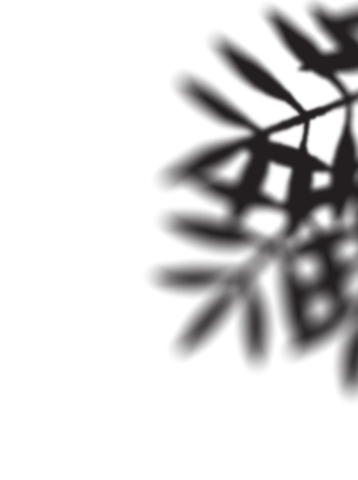
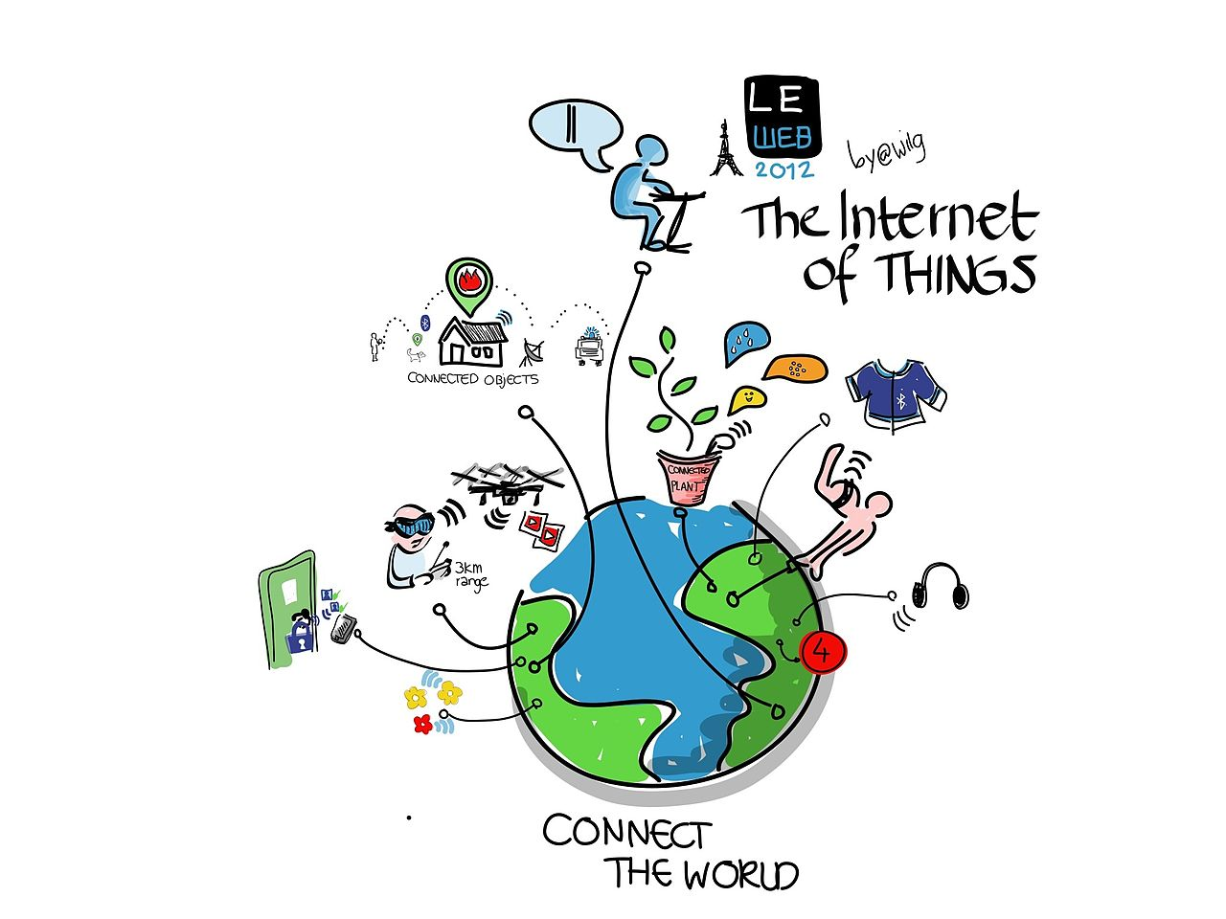
WHAT IS IOT?
The Internet of Things, or IoT, refers to the billions of physical devices around the world that are connected to the internet, all collecting and sharing data.

Slide 3
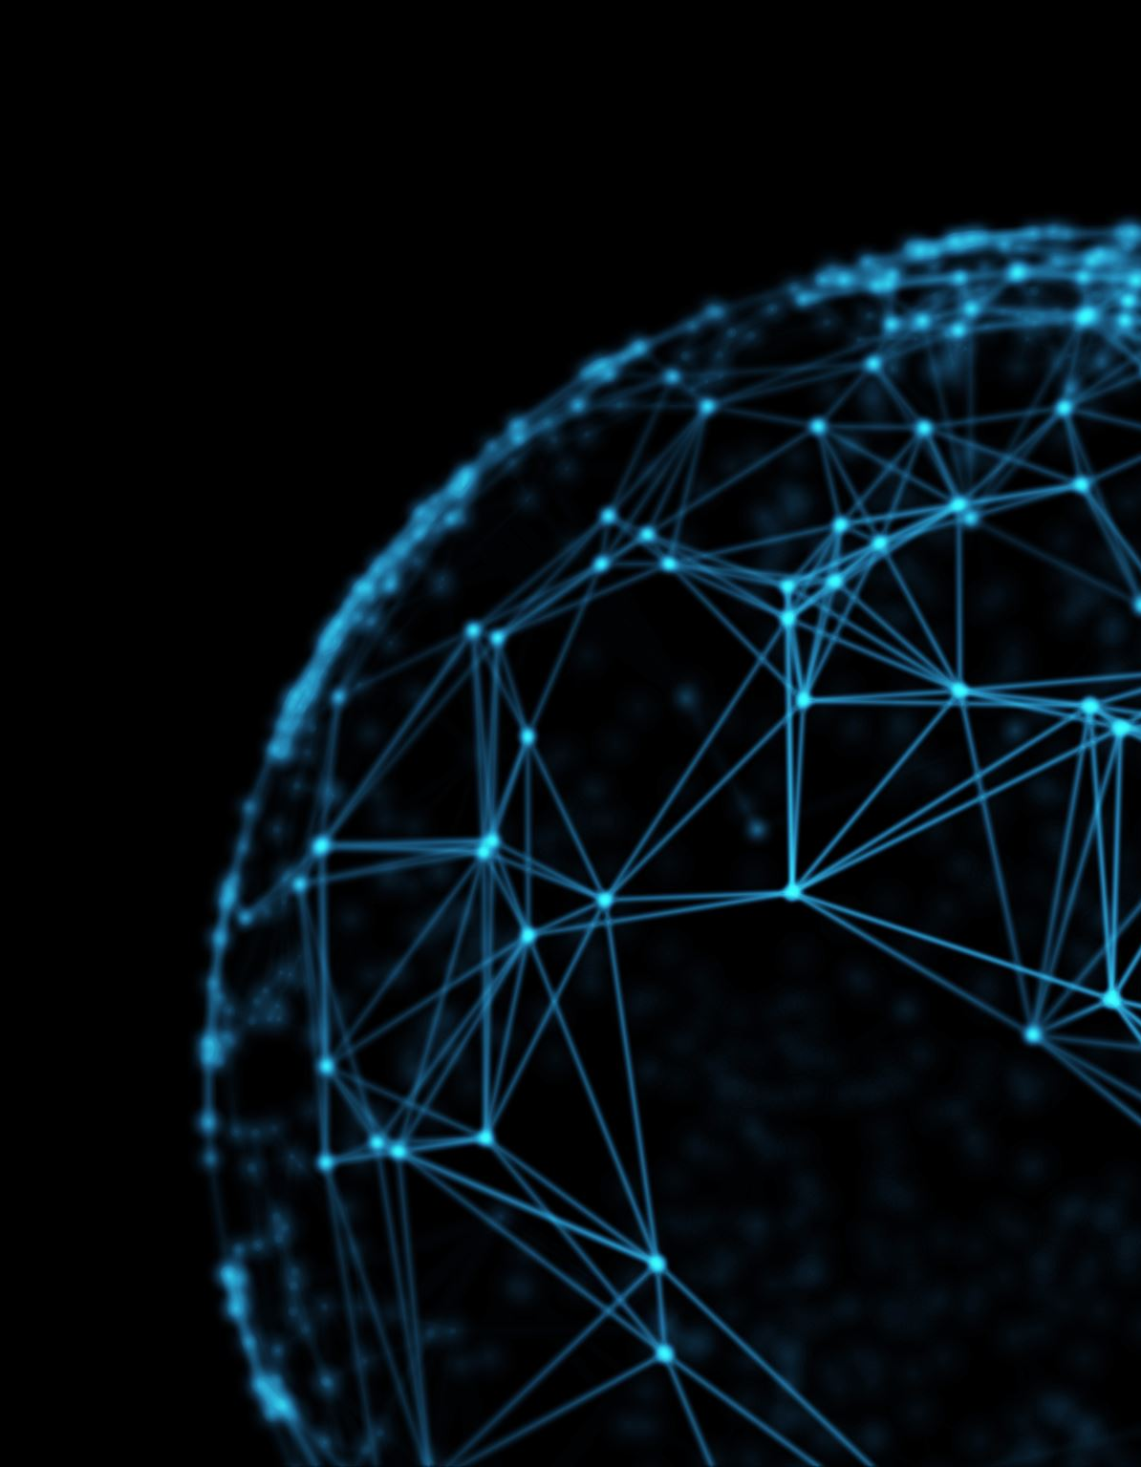
NEED FOR IOT
IoT aims to reduce human interaction with machines.
IoT wants to connect all potential objects to interact with each other on the internet to provide a secure, comfortable life for humans.
IoT helps people live and work smarter, as well as gain complete control over their lives.

Slide 4
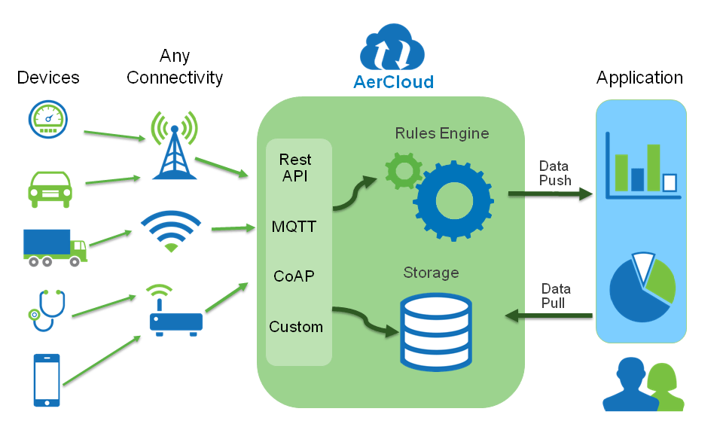
APPLICATIONS OF IOT
Environmental Monitoring
Infrastructure Management
Industrial Applications
Energy Management
Medical and Healthcare Systems
Building and Home Automation
Transport Systems
and much more!!!

Slide 5
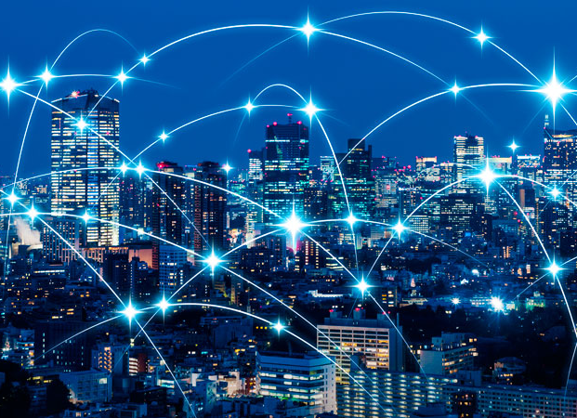
IoT enabled Smart City
Enhanced citizen safety
Optimized public services
Economic growth
Improved traffic flow
Improved environment

Slide 6
Healthcare IoT use cases
In-home patient care
Hospital equipment and supply asset tracking
Pharmaceutical tracking and security
Remote field medicine
Drug research
Patient fall indicators

Slide 7
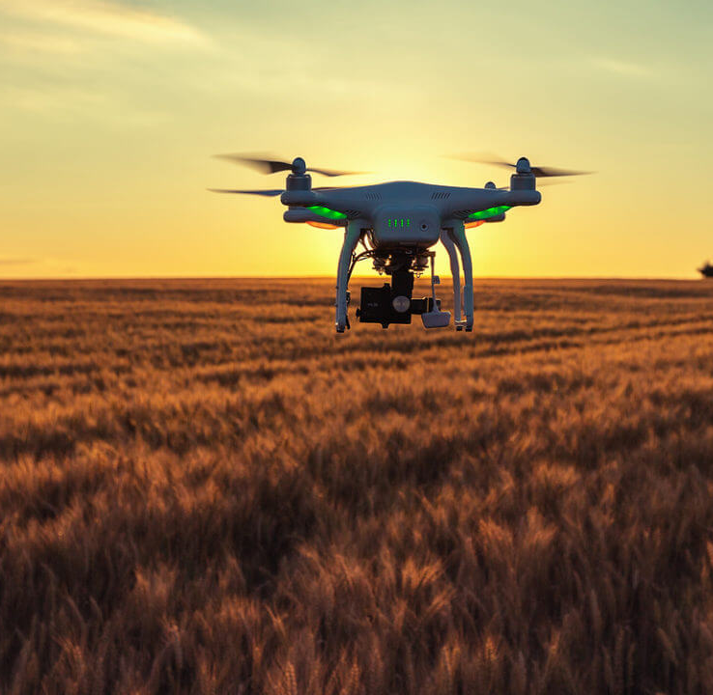
Agricultural and environmental IoT use cases
Smart irrigation and fertilization techniques to improve yield.
Smart lighting in nesting or poultry farming to improve yield.
Livestock health and asset tracking.
Drones-based land surveys.
Robotic farming.
Volcanic and fault line monitoring for predictive disasters.

Slide 8
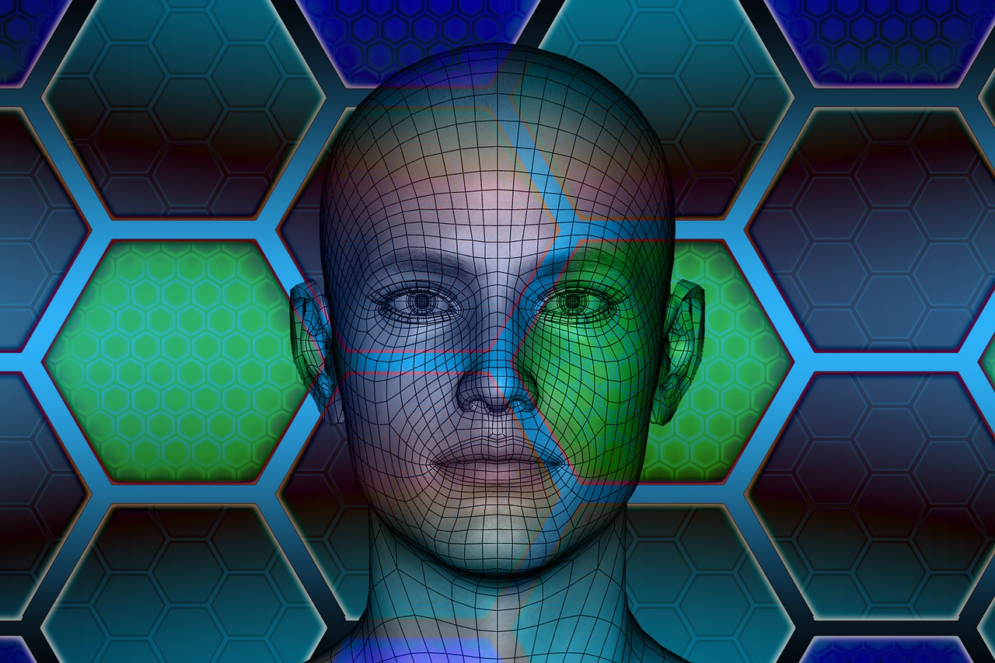
FUTURE SCOPE
Technology is advancing day by day. Individuals, governments, businesses all need smart management of their devices and only IoT can provide such.
Future scope of IoT has the potential to be limitless.
The future will need more automation.
In fact, everything is connecting for a smarter tomorrow!

Slide 9
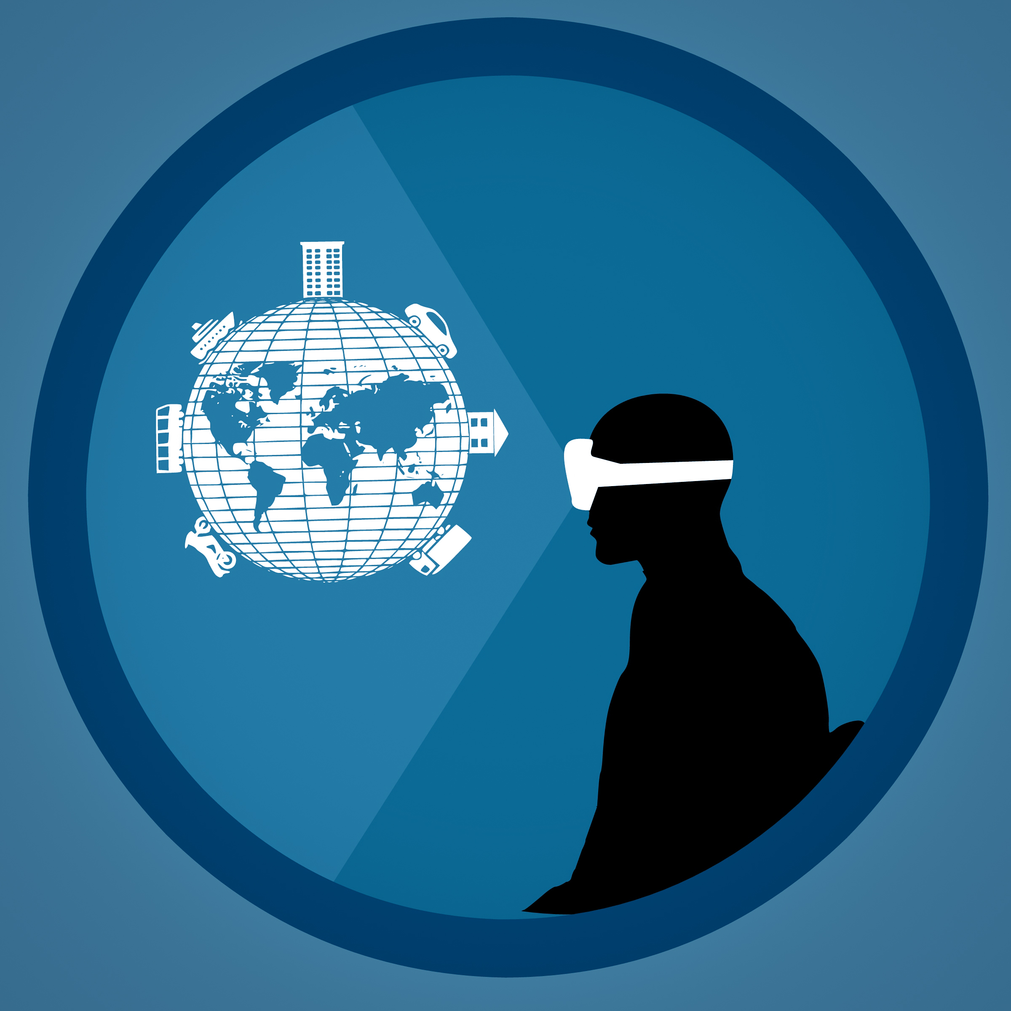
To build a better future. you need to have an innovative vision for the future. So what are you waiting for? Let’s take a step forward.

Slide 10
THANK YOU

